Slide 1


Slide 2
Backend Development
August 2024

Slide 3

Weekly Agenda
Week 1: Introductions
Week 2: Project Ideation
Week 3: Database Design and Setup
Week 4: Backend Development
Week 5: Javascript Frameworks
Week 6: Frontend Development
Week 7: Frontend Development and Putting it All Together
Week 8: Presentations

Slide 4
API Introduction
Backend Development
Tasks

Slide 5
API Introduction

Slide 6
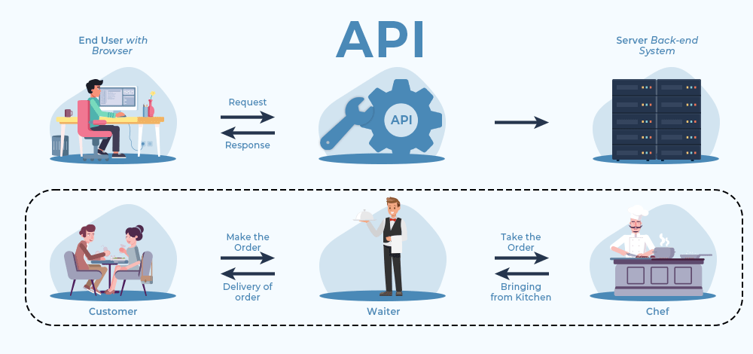
Introduction to APIs
What is an API?
Definition of an API (Application Programming Interface)
Real-world analogy (e.g., waiter taking orders in a restaurant)
Why APIs Matter
Importance in software development
Examples of API usage in daily life (e.g., social media, weather apps)

Slide 7
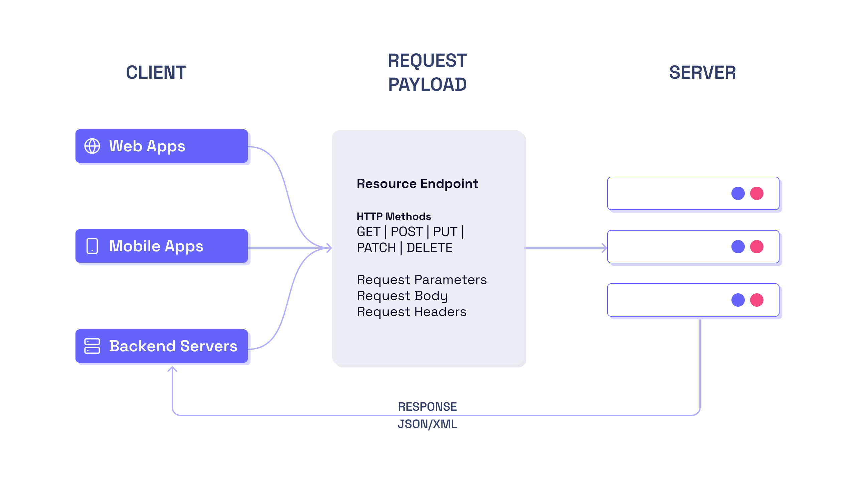
How APIs Work
Basic Concepts
Endpoints, Requests, and Responses
HTTP Methods (GET, POST, PUT, DELETE)
Data Formats
JSON vs. XML
Authentication
API Keys, OAuth

Slide 8
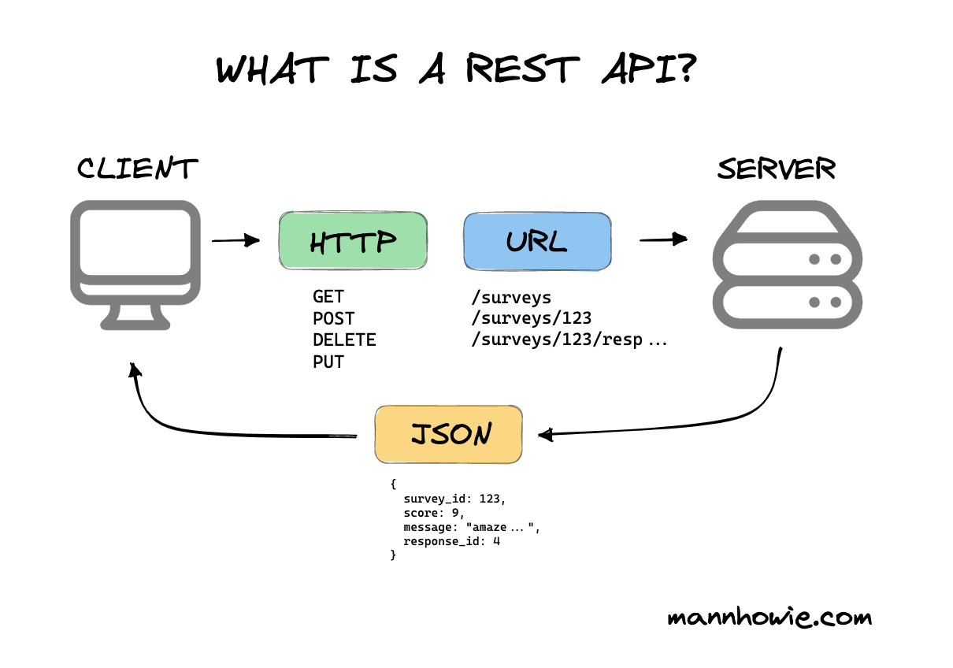
Types of APIs
RESTful APIs
Overview and principles (Stateless, Cacheable, etc.)
SOAP APIs
How SOAP differs from REST
GraphQL
Modern API query language
Webhooks
Event-driven APIs

Slide 9
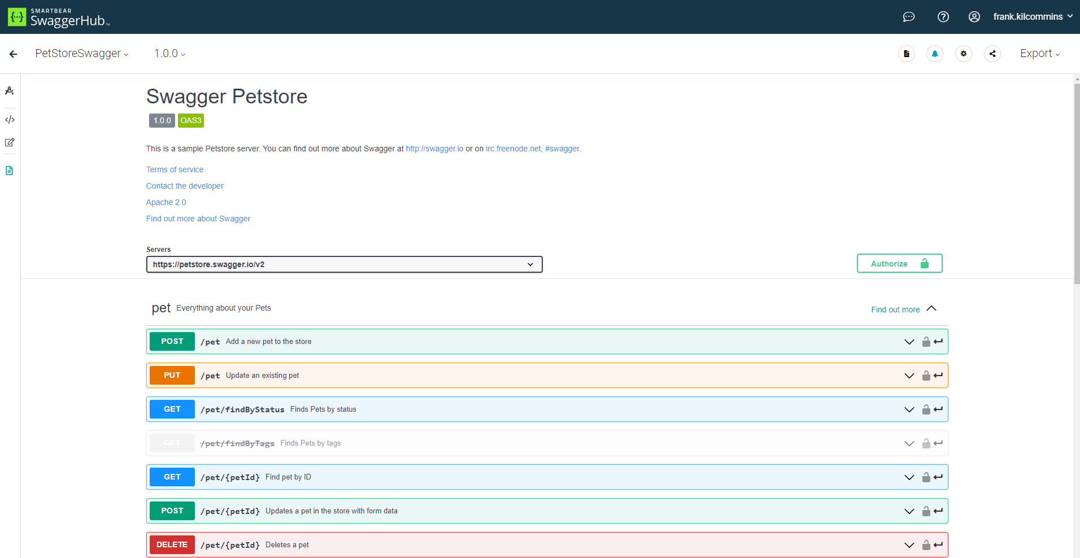
API Documentation
Importance of Good Documentation
How it aids developers
Tools for Documentation
Swagger, Postman
Best Practices
Clear examples, error codes, versioning

Slide 10
API Use Cases
Industry Examples
E-commerce (payment gateways)
Social Media (integration with platforms like Facebook, Twitter)
Cloud Services (AWS, Google Cloud APIs)
Public APIs
Overview of free/public APIs available for developers

Slide 11
Backend Development

Slide 12
Demo Time!

Slide 13
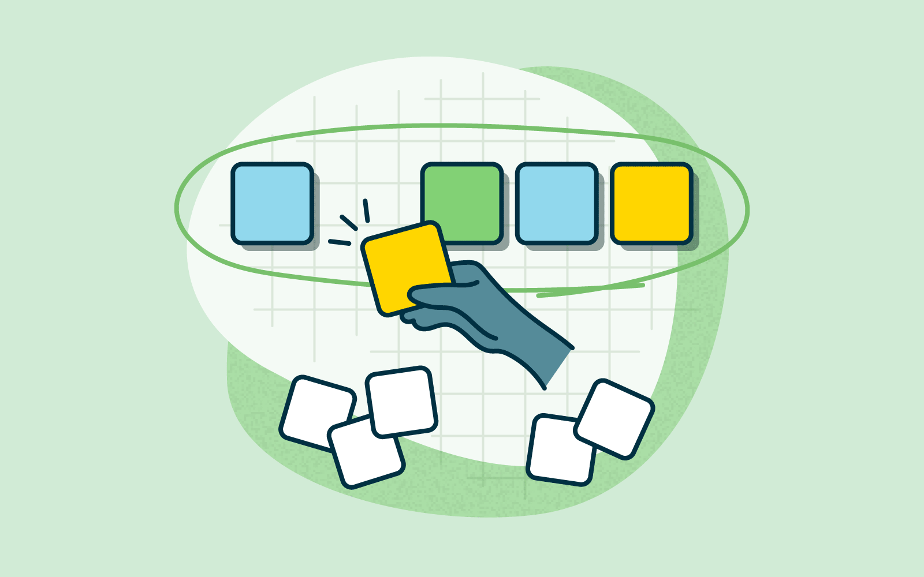
Tasks
Complete your backend endpoints.

